Slide 1
Back Against WallStreet

Slide 2
Current Scope
Front End tables display API Stock Info
Graph recommendations are working
Stock Search is working

Slide 3
Current Schedule
Accomplishments:
Add Stock Table and Graph
Home Page Checkboxes connect to Back End
Home Page displays Top Stocks
Ticker and Search implemented to Add Stock
Recommendation graph and filters
Not Achieved:
More checkboxes can be added
Recommendation needs more detail
Recommendation does not include watch list
Watch list needs to be saved to a csv

Slide 4
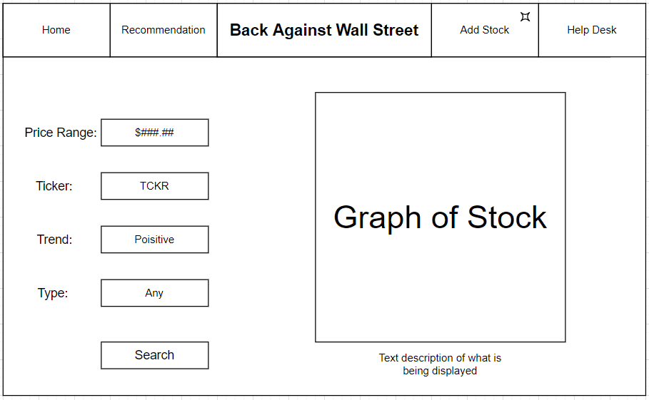
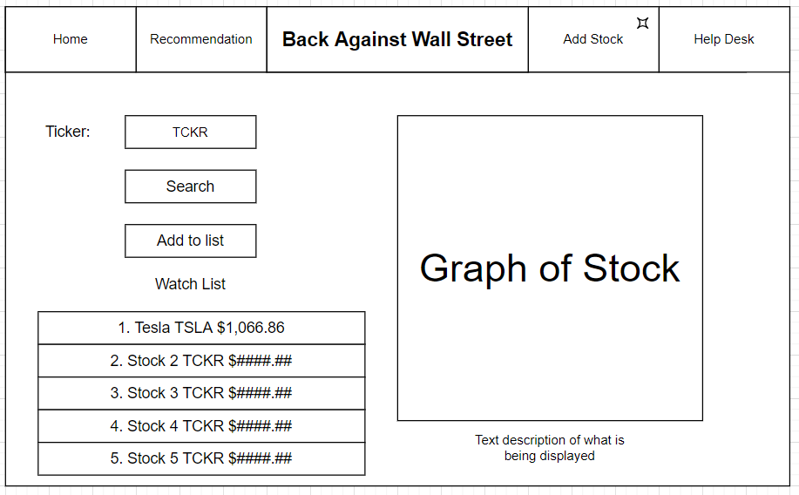
Sprint 4 Plans
Finish build of home page feature
Complete 3.2.2.3.2 REQ-2 test check boxes
Create more visually appealing design of website
Build Help Desk Feature
Complete 3.2.3.3.1 REQ-1
Build augmented Stock recommendation Feature
Complete 3.2.5.3.2 REQ-2 Augmented Stock Recommendation

